Slide 1
Chapter 8
Costing & Customer Profitability Analysis (CPA)

Slide 2
Objectives
After studying this topic you should be able to:
Understand the relationship between the marketing and management accounting functions;
Understand and use Activity Based Costing (ABC) and Activity Based Management (ABM) to support management decisions; and
Critically evaluate the use of; market segment profitability analysis, customer profitability analysis, and profit sensitivity analysis as tools to aid managers’ in hospitality, tourism and events environments.

Slide 3
Market decisions
An external focus of an organisation leads to decisions as to:
Which specific market are we in?
Who is our customer?
What do these customers want?
Can we deliver what they want?
Will this make us a profit?
Could other markets offer a better profit potential?

Slide 4
Market and customer examples (1)
What market are we in? | Who are our customers? | What do they want?
Events - Weddings | Those who want a bespoke service | Something designed specifically for them, a ‘one-off’ event, but prepared to pay for this ‘uniqueness’ desired from the event.
Events - Weddings | Those on a budget, but wanting a special day | They want a memorable day, cost is a concern so they want to select from pre-set all-inclusive packages that they can budget for.
Events – Music festival | 18-25 year olds with a passion for contemporary music | Top artists, mixing with like-minded individuals, basic camping facilities, bar facilities and a simple food provision.
Events – Music festival | Families | A safe friendly environment, with good music for the adults, but also entertainment for the children, with workshops and family focused camping facilities, quality food & drink provision.

Slide 5
Market and customer examples (2)
What market are we in? | Who are our customers? | What do they want?
Hospitality 5* hotel (International Airport) | Airline crew and air passengers | A one night stay with easy access to the airport, possibly parking whilst away, 24 hour services so they can arrive, eat and leave at a time convenient to flight needs.
Hospitality 5* hotel (city centre) | Overseas travellers at the ‘high end’, & corporate executive business travellers | Traditional hospitality, opulent surroundings, attention to service details, traditional hotel styling & atmosphere, like-minded customers
Hospitality 5* hotel (city centre) | Entertainment and creative industry corporate executives, younger celebrities, ‘young money’ | Want 5* facilities, but with a lively, vibrant modern atmosphere in a hotel with a contemporary style and modern service and up-to-the-minute gadgets and technology.

Slide 6
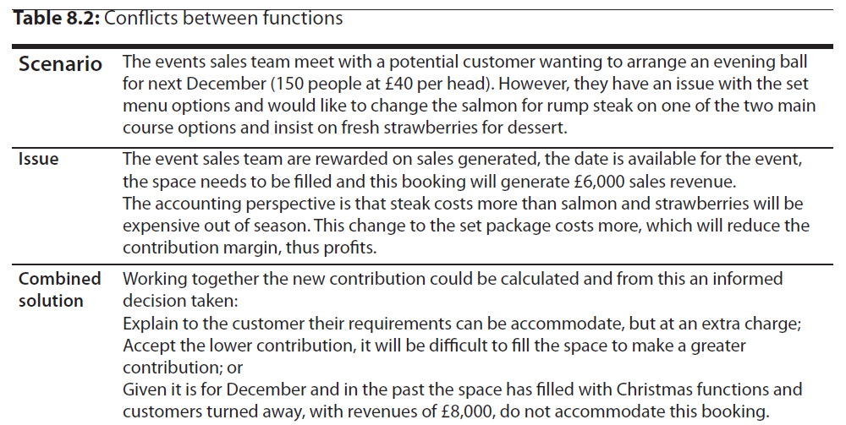
marketing/accounting interface (1)

Slide 7
marketing/accounting interface (2)
Scenario | Issue | Combined solution
A coach tour operator contacts the hotels central reservation team, they want to book 30 rooms in your hotel for next March for Saturday night. The numbers of rooms are available to be booked and you have a special discounted rate with this tour operator. | The reservation team are rewarded on the number of room sold, the rooms need to be filled and, even at the discounted rate, 30 rooms @ £50 each represents £1,500 sales revenue. | From the accountants perspective financial data might show: There is a buoyant weekend break market, booking these rooms for Saturday night will make them difficult to sell Friday for one night – an opportunity cost; This tour operator has been very slow to pay its bills in the past, requiring a lot of chasing and there is concern over their credit rating. This could lead to cash flow problems as the amount of trade receivables (debtors) increases or bad debts in the future; or This is a great opportunity and these customers tend to have a high ‘secondary spend’ in the bar and spa facilities making this a good opportunity.

Slide 8
marketing/accounting interface (3)
Scenario | Issue | Combined solution
A new spa treatment is priced by the accounting department using a cost-plus approach and calculates the 1 hour treatment should be sold at £65. | The accounting team are taking no account of the market, what the customer is prepared to pay or the completion. | The marketing department establish that there is competition locally offering the same treatment (customers can go elsewhere) and the prices range from £52 - £62. Given this market data the product price can be set considering the market: Set at the lower end of the market, £55 to attract customers in to try the new product; Given the quality and reputation of the spa, priced at £65 to identify it as a premium product in the market; or Set at the psychological price of £59, being under the £60 boundary.

Slide 9
Activity Based Costing (ABC)
"A system of management which uses activity based cost information for a variety of purposed including cost reduction, cost modelling and customer profitability analysis."
(CIMA official terminology)

Slide 10
Key elements of ABC include:
Cost visibility - Brings costs out into the open and allows managers to ask if their department is as cost effective as it could be.
Activity cost profile - This is a way of presenting data (like an overhead reporting statement) allowing the asking of questions like why has the cost of quality control risen.
Identifying value added - Allows differentiation between costs which add value and those which don't. This can be used for further development into three categories core, support and discretionary costs. This enables better cost management by reducing resources on non-core activities.
Cost behaviour patterns - It is not always clear how and why cost behave as they do. An ABC based cost hierarchy can identify how costs are driven and again focus on cost reduction.

Slide 11
ABC simple example

Slide 12
Solution

Slide 13
Solution (cont)

Slide 14
Solution (cont)

Slide 15
ABC uses
It can aid managers in identifying services, products, departments and activities that are profitable or those making a loss;
It can aid operational level financial control;
It can identify unnecessary costs for management action; and
It can be used in cost-plus pricing (see pricing chapter).

Slide 16
Activity Based Management (ABM)
Operational ABM:
‘Actions, based on activity driver analysis, that increase efficiency, lower costs and/or improve asset utilisation.’
CIMA Official Terminology, 2005
Strategic ABM:
‘Actions, based on activity based cost analysis, that aim to change the demand for activities so as to improve profitability.’
CIMA Official Terminology, 2005.

Slide 17
Customer Profitability Analysis (CPA)
CPA uses the ABC approach to costing to track costs by activities associated with customers, not individual products and services.

Slide 18
Customer profitability Analysis in action (1)
Sector | ‘Bundled’ Products/services – bought as combined package | Products/services – bought individually
Tourism | The packaged tour, including in one price: Plane travel, transfers, accommodation, and all meals. | Plane travel, transfers, accommodation, meals, travel insurance, currency exchange, day trips, drinks, upgrades, car hirer.
Events | VIP package, including in one price: Event ticket, programme, hospitality food & drink package. | Event ticket, programme, food, drink, merchandising, travel.

Slide 19
Customer profitability Analysis in action (2)
Sector | ‘Bundled’ Products/services – bought as combined package | Products/services – bought individually
Hospitality | Full board – room, breakfast, lunch & dinner | Room, breakfast, lunch, dinner, bar sales, in-room entertainment, spa treatments, golf green fees, merchandising.

Slide 20
Traditional v. CPA approach
(Adapted from Harris 2011)

Slide 21
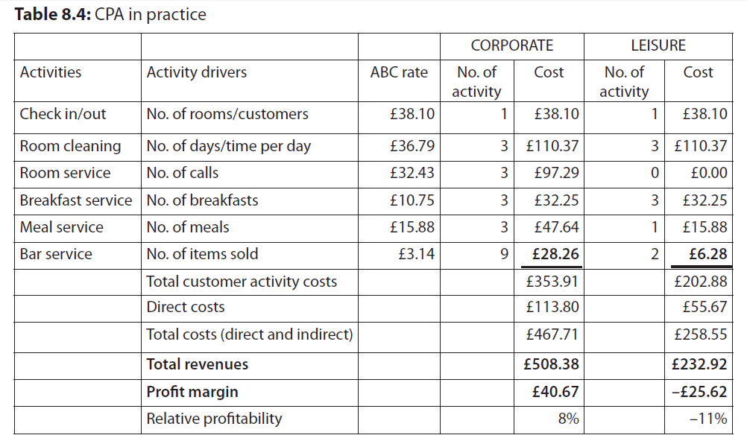
CPA example

Slide 22
How can CPA aid managers’ decision making? (1)
explicitly identifying which customer groups (segments) generate the most profit can aid the targeting of resources and marketing efforts to these groups;
providing information that can aid cost reduction, by highlighting costs by activities gives managers’ the chance to review the need of activities or how their costs can be reduced;
assisting pricing of products, particularly packages and discounting for certain customer groups;

Slide 23
How can CPA aid managers’ decision making? (2)
allowing markets to be segmented on profitability, not just revenues;
aiding a differentiation strategy;
providing information for making more informed decisions.

Slide 24
Profit Sensitivity Analysis (PSA)
Profit sensitivity analysis is another tool to aid managers’ in understanding their business in more detail. As the name suggests, PSA concerns understanding how sensitivity profits are to changes, these could be changes in revenues, or changes in specific costs.
An example would be:
What is the impact on profits if an individual variable (volume, selling price, or a cost element) changes by 10%?

Slide 25
PSA
Profit multiplier = % change in profit
% change in key factor

Slide 26
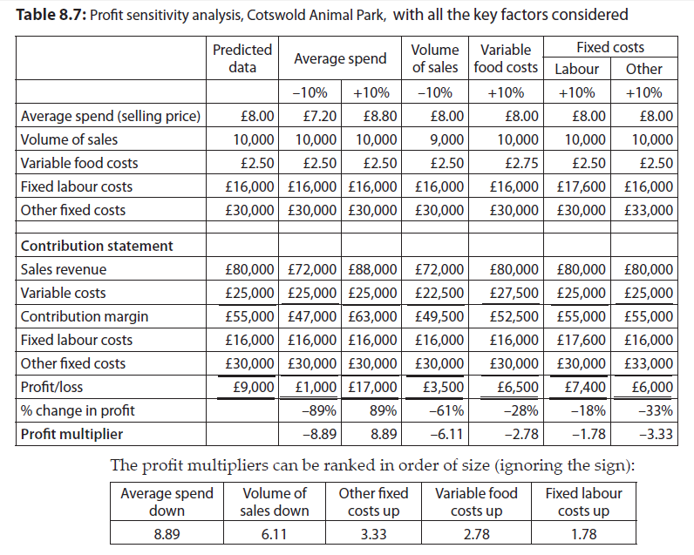
PSA Example

Slide 27
PSA use and criticisms
Gives an understanding of impact changes, therefore what to focus management time on controlling.
However it ignores the likelihood of such changes and views them in isolation.

Slide 28
Summary
To maximise profits you need to focus on the most profitable customers, but need a mechanism to know who they are.
The combined roles of marketing and the accounting function can do so much more than working independently.
Activity based costing is an alternative to traditional absorption costing and proves more useful in service situations.
Customer Profitability Analysis (CPA) allows managers to identify the profits associates with customers, as opposed individual departments, products or services.
In complex environments were customers buy multiple services and products it is customers not products that need to be tracked to maximise financial returns.
Profit Sensitivity Analysis (PSA) aids managers in understanding the relationship between individual costs and their impact on profits.

